Slide 1

Financial Services Hack to Learn Insurance Claims Automation
Chris Kabat – Data & AI Specialist, Insurance
Ashish Talati – Cloud Solution Architect – Data & AI
Kapil Dhanger – Cloud Solution Architect – Data & AI
Pratima Valavala - Cloud Solution Architect – Data & AI

Slide 2
Agenda
Eastern Time Zone | Thursday November 4th
11:30AM-12:10PM EST | Welcome & Opening Remark – Jose Thomas Keynote – Nate Harris
12:10PM-12:40PM EST | Industry Speakers & Perspectives
12:45PM-3:15PM EST | Hack-To-Learn Day 1
3:15PM-3:30PM EST | Closing
Eastern Time Zone | Friday November 5th
11:30AM-11:40AM EST | Welcome Back and Day 1 Recap
11:40AM-2:10PM EST | Hack-To-Learn Day 2
3:15PM-3:30PM EST | Closing & Next Steps

Slide 3










Azure AI for Financial Services All-Up
Combat financial crime
Differentiated customer experiences
Modernize payments, core banking & insurance
Fraud Prevention
Risk Assessment
Intelligent Contact Center
Personalized Marketing & Offers
Intelligent Conversational Agents
Process Automation
Document Intelligence

Slide 4

Importance of digital channels and efficient document ingestion

Slide 5

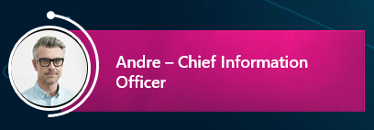
AI-Powered Insurance Claims Automation
Chief information officer Andre is responsible for making sure that all Customer data is ingested properly and is available for any other application or organization.
A large portion of information submitted by customers comes in either handwritten or scanned forms. Woodgrove spends manual labor hours to scrape and digitize the data.
The manual process has slowed down the pace of business and adds significant cost. To enhance the customer experience and cut expenses Andre is looking to use Artificial intelligence and other Azure services to automate this process.

Slide 6
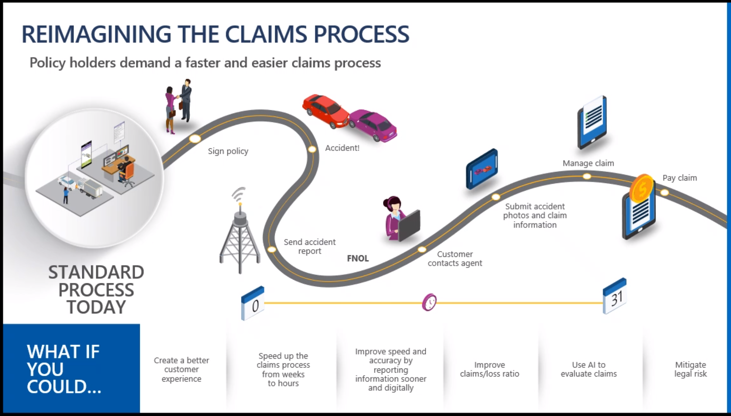

Slide 7










AI-Powered Insurance Claims Automation - Architecture
User Input
Channels
Azure Bot + Cognitive Services
Analytics
Power BI
Text
ID Model
Speech
Storage
Logic app
Invoice Model
Data store
Business Process
Image
NLP
Insurance Model

Slide 8





Many Hats of a data driven Organization
Responsible for business needs and outcomes
Responsible for training AI models
Responsible for Process automation
Responsible for designing user interfaces
Responsible for end to end testing
Business Owner
Data Scientist
Automation/RPA Engineer
User interface
Dev
End to End Acceptance

Slide 9
AI-Powered Insurance Claims Automation - Architecture
User Input
Channels
Azure Bot + Cognitive Services
Analytics
Power BI
RPA Engg
Text
ID Model
Speech
Storage
Logic app
Invoice Model
Data store
Business Process
Image
NLP
Insurance Model
User interface
Dev
Data Scientist
Business Owner

Slide 10
Day 1
Orientation and context and tech setup 30 mins
Background
Environment
Needed assets
Hack format
Hack & learn 1 Business owner 10 min
Business problem summary
Hack & learn 2 Data Scientist 90 min
Forms Recognizer intro and demo
Forms recognizer prebuild DL model test
Label and train a new model for Insurance
Custom vision intro and demo
Custom vision training and testing

Slide 11
Day 2
Hack and Learn 3 – Automation/Data Engg 60 mins
Introduction to logic apps
Introduction to cosmos db
Plug in models
Test using upload to storage account
Introduction to Cognitive search
Test cognitive search
Hack and learn 4 – User interface Dev 60 min
Introduction to bot framework
Integrate models with bot
Web interface
Hack and learn 5 – End to end test 30 mins

Slide 12
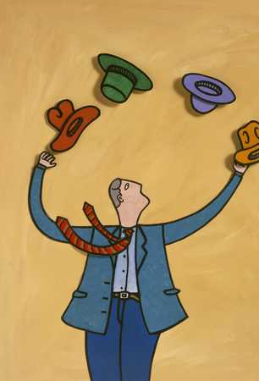
Event format
All participant will wear a dawn different personas and complete the subset of challenges.
This hack to learn has 5 challenges corresponding to 5 different personas.
Each challenge has detailed objectives – to complete a challenge
Complete the acceptance criteria
Post relevant details on the channel chat
For each challenge, the coach will give you a technology overview and walkthrough.
You would also be provided with detailed instructions if needed.
If you are stuck or have immediate questions raise your hand and one of the coaches will assist you.

Slide 13
Hat 1
Objectives
Understand the business context of the challenge
Acceptance criteria
Business owner write a short summary of project goals for the IT team.
Define high level expectations of the project
Business Owner
Est. time 15 mins

Slide 14

Before you throw your hat
Post the output artifacts on the group chat
Post any open questions on the chat

Slide 15
Introduction to custom vision

Slide 16
Hat 2
Objectives
Train custom vision
Acceptance criteria
Custom Model
Train Forms recognizer model
Understanding of out of the box AI model
Data Scientist
Est. time 90 mins

Slide 17
Introduction Forms recognizer

Slide 18
Introduction to Logic App

Slide 19
Objectives
Build workflow to automate the business process
Trigger workflow when new document is uploaded
Acceptance criteria
Process the documents using the out of the box models or custom model created in previous hack
Share details of the automated business process
Automation/RPA Engineer
Est. time 60 mins

Slide 20
Introduction to Cognitive search

Slide 21
Introduction to Bot framework

Slide 22
Objectives
Connect to cognitive search
Build search interface to visualize the documents
Acceptance criteria
User Interface/Dev
Documents are available in near real time on the dashboard

Slide 23
Objectives
Test end to end project with bot interface
Acceptance criteria
End to End Acceptance
Processing the data and visualizing in the web tool

